Slide 1




Using Pub-Sub Model for Data Integration

Slide 2
Agenda
What is Pub-Sub Model
Implementation Systems for Pub-Sub model
Azure Portal
Service Bus
Event Hubs
Difference
Steps to achieve the Integration

Slide 3
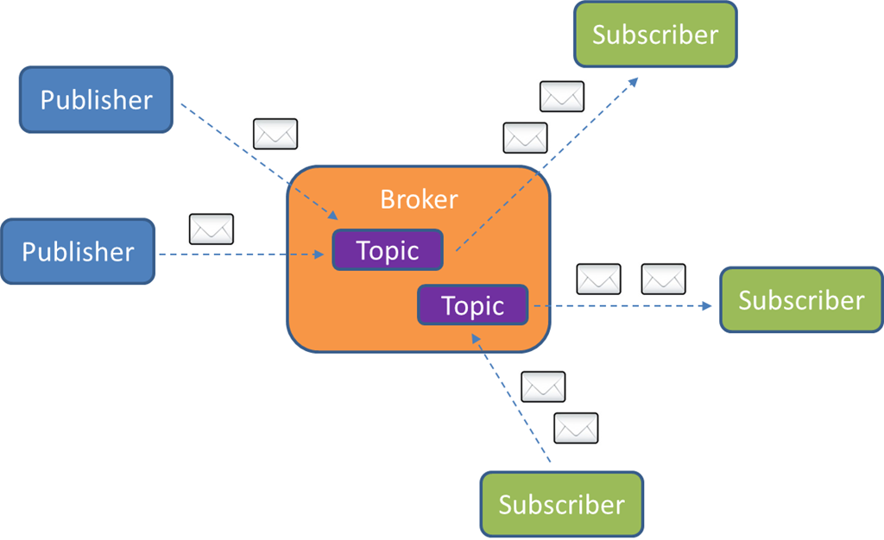
Pub-Sub Model
Publish/subscribe messaging, or pub/sub messaging, is a form of asynchronous service-to-service communication used in serverless and microservices architectures.
In a pub/sub model, any message published to a topic is immediately received by all of the subscribers to the topic.
Event-driven architectures
Decouple applications in order to increase performance, reliability and scalability.

Slide 4
Implementation Systems
Azure Portal
PubNub API
Amazon Simple Notification Service
Amazon Simple Queue Service
Google Cloud Pub Sub Etc..

Slide 5
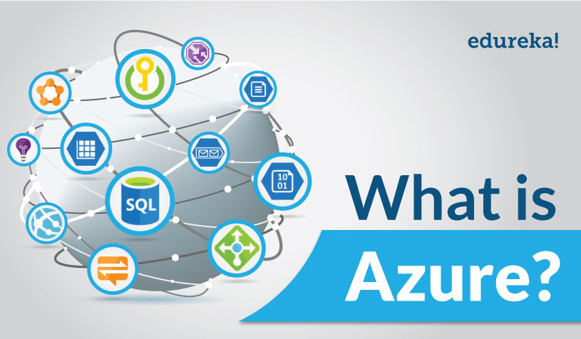
Azure Portal
Microsoft Azure is a cloud computing platform and infrastructure created by Microsoft for building, deploying, and managing applications and services through a global network of Microsoft-managed data centers. Users can manage Azure services using the Web-based Azure portal (sometimes referred to as the Azure Resource Manager (ARM) portal). The portal allows users to browse active resources, modify settings, launch new resources, and view basic monitoring data from active virtual machines and services.

Slide 6
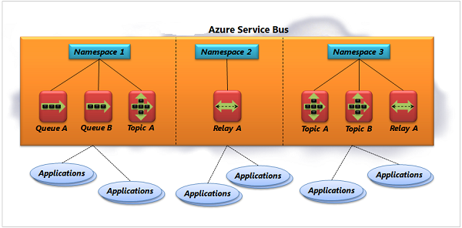
Microsoft Azure Service Bus is a fully managed enterprise integration message broker. Service Bus is most commonly used to decouple applications and services from each other, and is a reliable and secure platform for asynchronous data and state transfer. Data is transferred between different applications and services using messages. A message is in binary format, which can contain JSON, XML, or just text.
It follows the One Publisher Multiple Subscriber pattern.

Slide 7
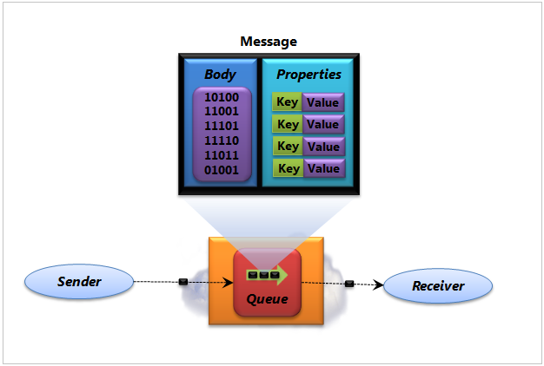
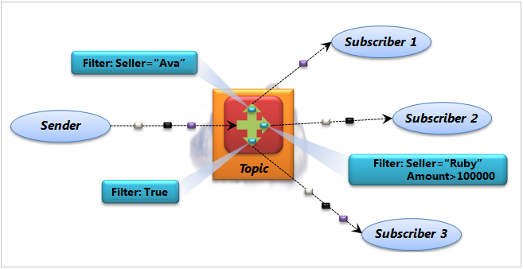
Service Bus
Queues
Topics
Receive & Delete & PeekLock

Slide 8
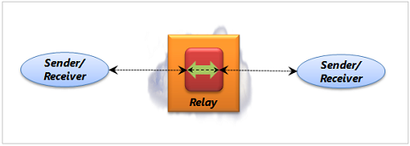
Service Bus
Relays
Two way communication between sender and receiver
Broker doesn’t store any messages
Relay is created automatically, when an application that wishes to receive messages establishes a TCP connection with Service Bus
Windows Communication Foundation (WCF) is used by apps for relays as Service Bus provides WCF bindings

Slide 9
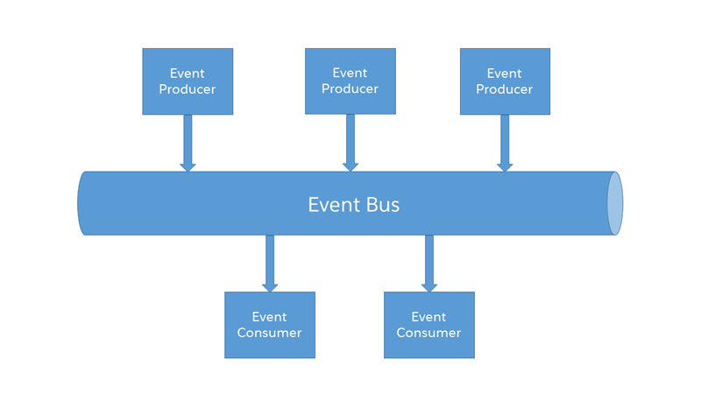
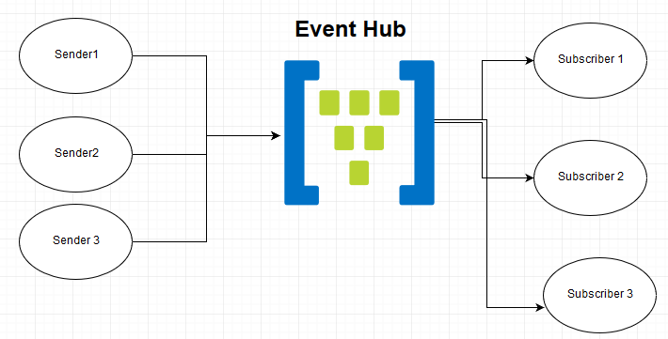
Event Hub
Azure Event Hubs is a highly scalable data streaming platform and event ingestion service, capable of receiving and processing millions of events per second. Event Hubs can process and store events, data, or telemetry produced by distributed software and devices. In Event hub there can be multiple sender and multiple receiver . Azure Event Hubs is a scalable event processing service that ingests and processes large volumes of events and data, with low latency and high reliability.

Slide 10
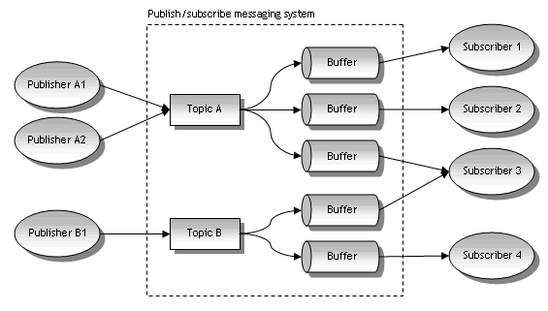
Pub-Sub Model (Azure)

Slide 11
Service Bus VS Events Hub
Similarities
Differences
Request/Reply vs event notification
Costs
Scalability
In Service Bus Messaging a receiver can read a message from a queue and then it will be deleted once successfully processed. In Event Hubs the receiver does not remove messages from the stream and instead would manage its own index or check point to know where its position in the stream is.
Both entities live within an Azure Service Bus Namespace and can be managed in that part of the Azure Portal.
Both entities can also support an HTTP interface
Both entities have durability features so that a message can be persisted and received later
Both entities support a kind of time to live style feature but they are not necessarily the same
Both options support the same SAS security model by default for sending, receiving and management
Both options have the same 256kb message size limitation

Slide 12
Steps
Create a Service Bus namespace, using the Azure portal.
Create a Service Bus topic, using the Azure portal.
Create a Service Bus subscription to that topic, using the Azure portal.
Add Service End Point to send messages.
Write a .NET console application to receive those messages from the subscription.

Slide 13
Thank you…

